Slide 1
Realtime Graphics
Guest lecture in “Datorgrafik med Interaktion”
by Mikael Kalms

Slide 2
Me, myself and I
Mikael Kalms
33 years old
Studied M.Sc at LiTH
Programmer at EA DICE
Used to do rendering / systems work
Nowadays more online stuff
Graphics programming is still a hobby of mine!

Slide 3
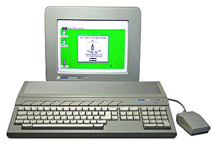
My formative years

Slide 4
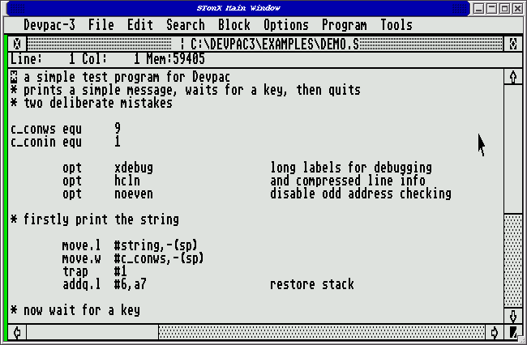
My first assembler

Slide 5
Back then, this was cool:
http://www.youtube.com/v/BLYCwFjzaaA

Slide 6
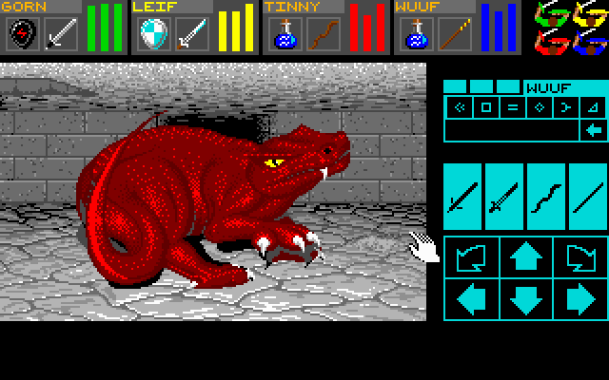
Back then, this was fresh:
(Still is, if you ask me...)

Slide 7
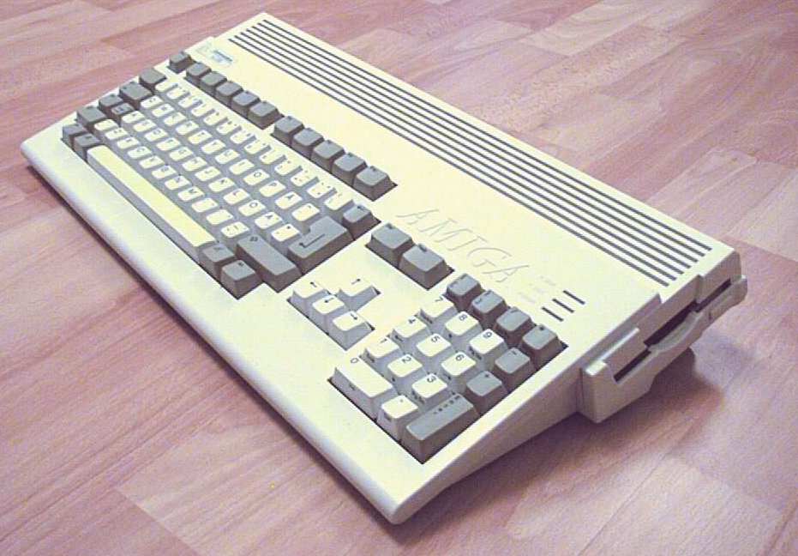
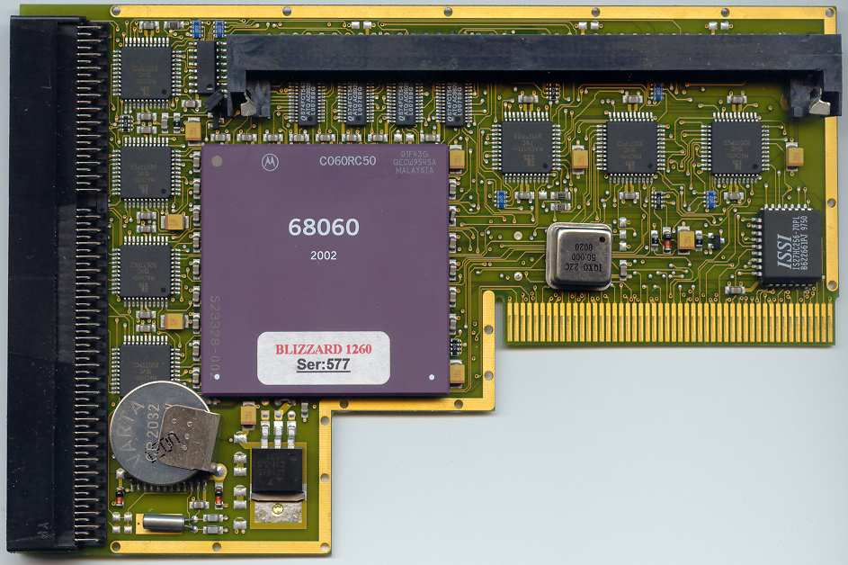
My machine of choice since 1994
+

Slide 8
50MHz is plenty.
http://www.youtube.com/v/4vW0U5zB4JA

Slide 9
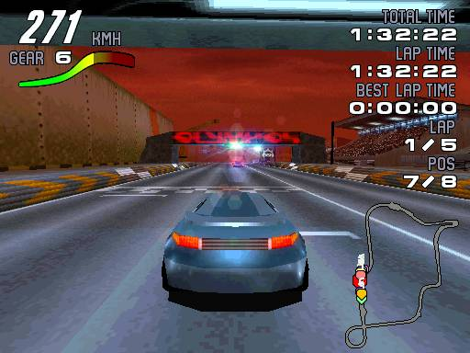

I've worked on games.

Slide 10
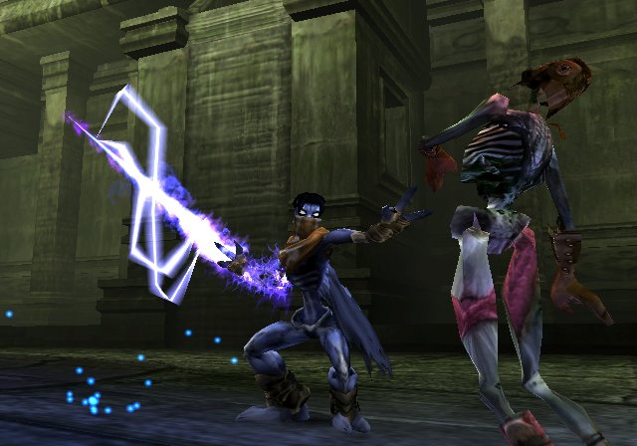
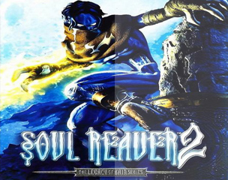
I've worked on games.

Slide 11
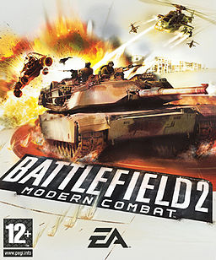
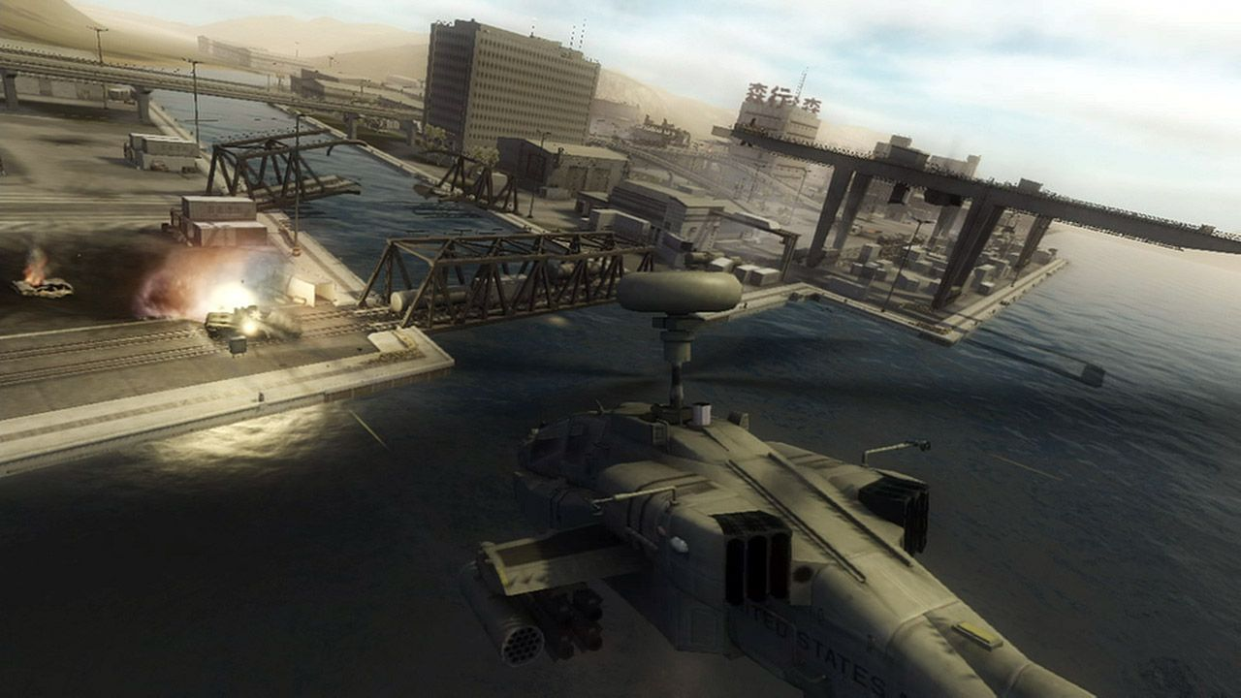
I've worked on games.

Slide 12

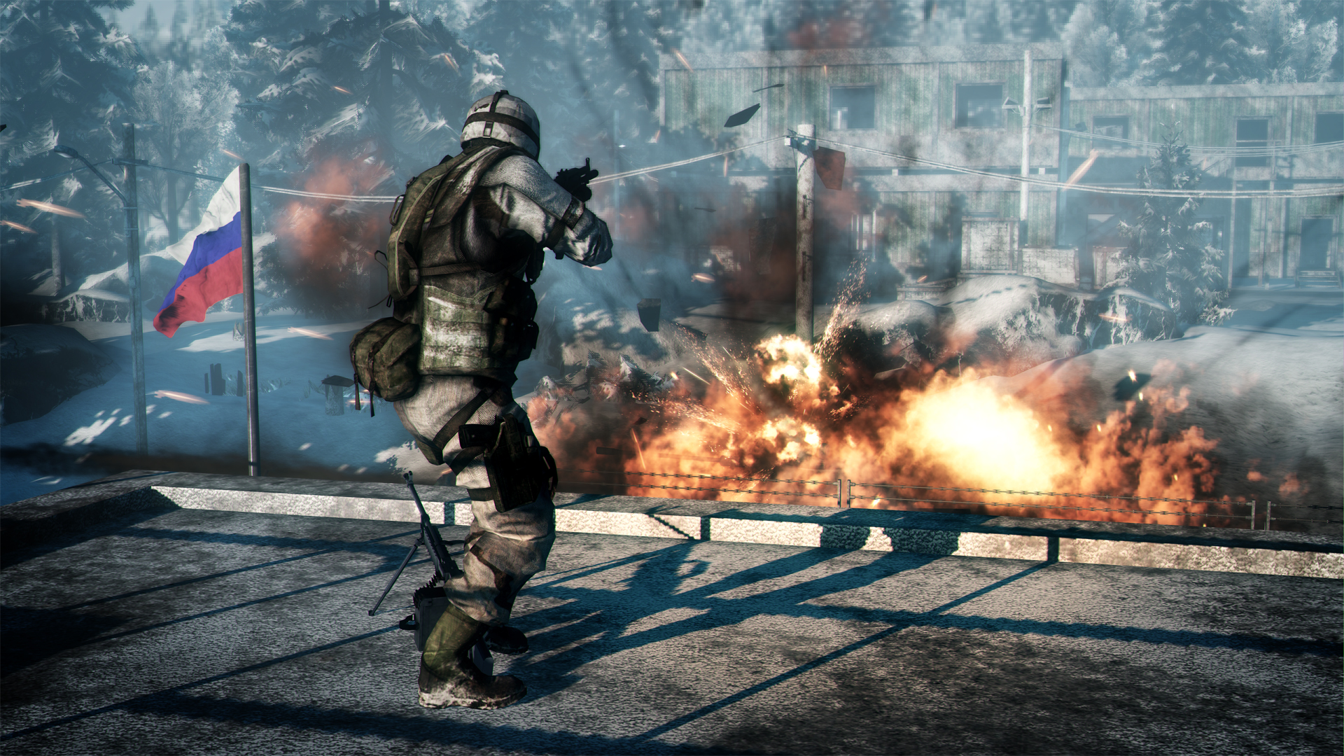
I've worked on games.

Slide 13

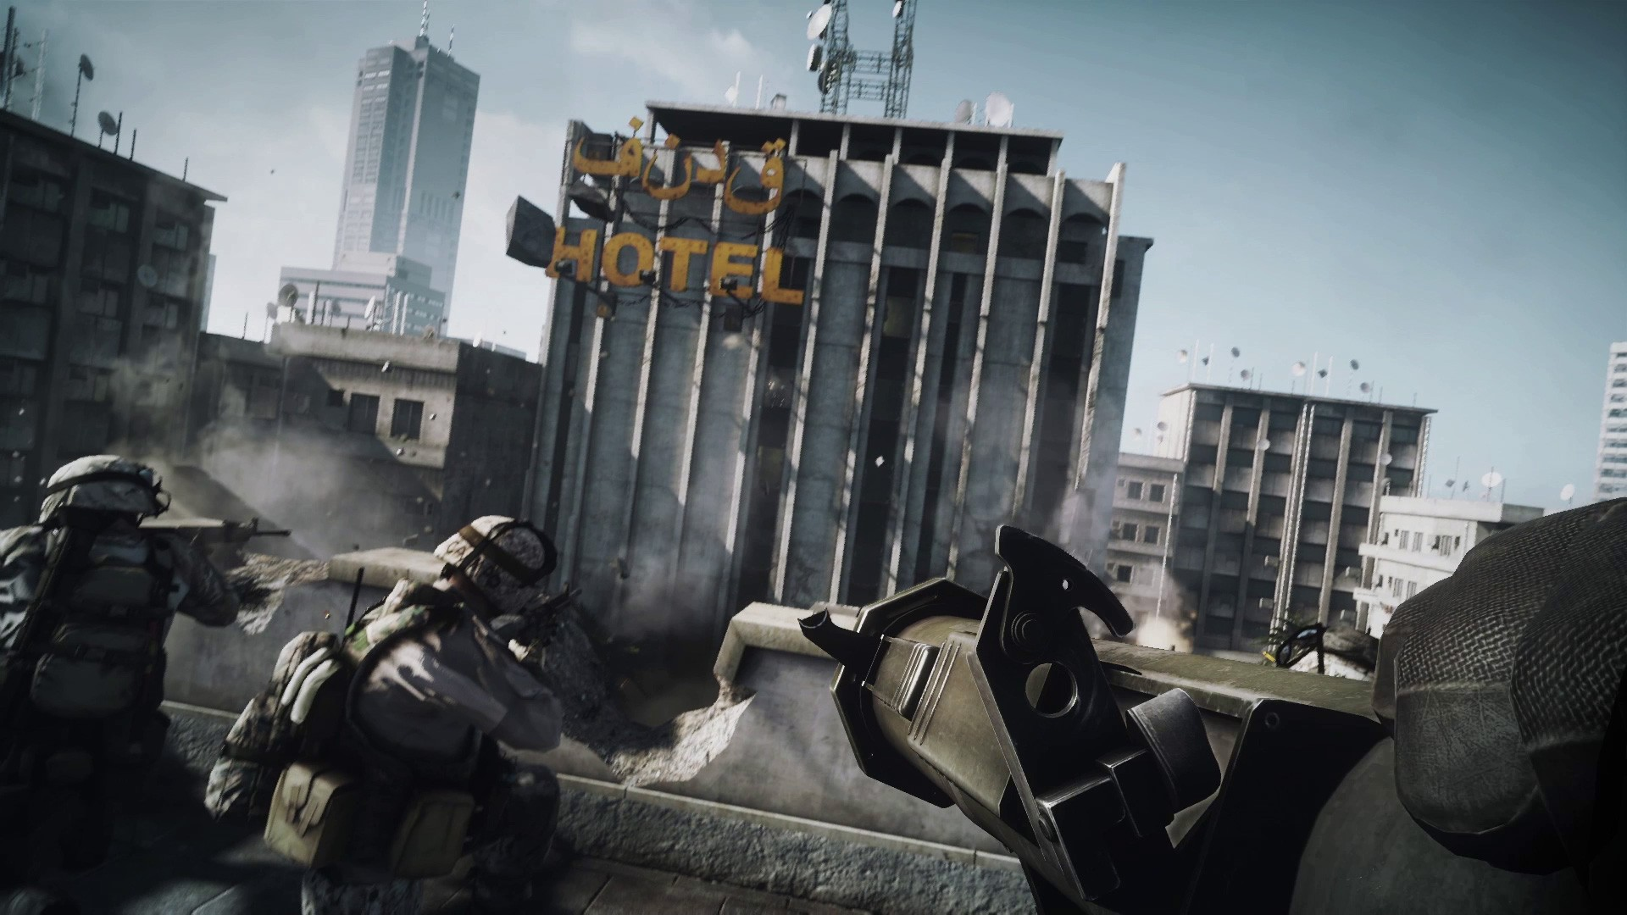
I've worked on games.

Slide 14
But, back on topic.

Slide 15
Characteristics of realtime graphics
10-100 images/second generated (so: high throughput)
If it's interactive, then latency is also important
Minimum performance is important; it is often better to have consistent performance, than high peak performance

Slide 16
My approach to realtime graphics programming
50% play around
50% directed work

Slide 17
My choice of language: C++
Why?
“the most advanced assembler on the market”
Available on nearly all machines
Can access native APIs on nearly all OSes
Control over memory management
Control over memory layout
Control over CPU usage
Control over code generation
No garbage collection
You can use other languages too, but you are then limiting yourself.

Slide 18
Things to come
Before the break, we will discuss...
Our test harness.
Image processing.
Image bending.

Slide 19
A. Our test harness
Blank canvas
What's an Image?
What's a FloatRGBColor?
How do RGB colors work?
How do I draw a pixel?

Slide 20
B. Image processing
Displaying an image.
Computations on color values.
Computations on color components.
FIR low pass filter.
IIR low pass filter.

Slide 21
FIR filter: concept
Output pixel = weighted combination of some neighbouring input pixels

Slide 22
IIR filter: concept
Output pixel = weighted combination of some neighbouring input pixels AND some neighbouring output pixels

Slide 23
C. Image bending
How do we scroll an image?
Per-line distortion.
Image zooming (map source → dest)
Image zooming (map dest → source)

Slide 24
Relax.
It's break time.
Regroup in 15.

Slide 25
Things to come
Rendering filled shapes...
… using per-pixel test
… using scanconversion
… using spantables
And then, filling the shapes with interesting bits
Finally, let's do something interesting with our tools.

Slide 26
E. Per-pixel test
How do we draw a circle?
Drawing a halfspace.
Drawing a triangle.

Slide 27
Circle equation
x^2 + y^2 <= r^2

Slide 28
Halfspace equation
Ax + By + C >= 0

Slide 29
Triangle equation set
Set up one halfspace eqn per edge.
If halfspace1 && halfspace2 && halfspace3 holds, then (x,y) is inside the triangle.

Slide 30
F. Scanconversion / spantables
Why scanconversion?
Draw circle using scanconversion.
Draw triangle using scanconversion.
Draw triangle using spantables.

Slide 31
G. Shading our triangles
Gouraud shaded triangle
Texturemapped triangle

Slide 32
H. Using our texturemapper
Zoomrotator.
Image distorter.
Tunnel.

Slide 33
The end.
Questions?
Reach me at: mikael@kalms.org

